Slide 1
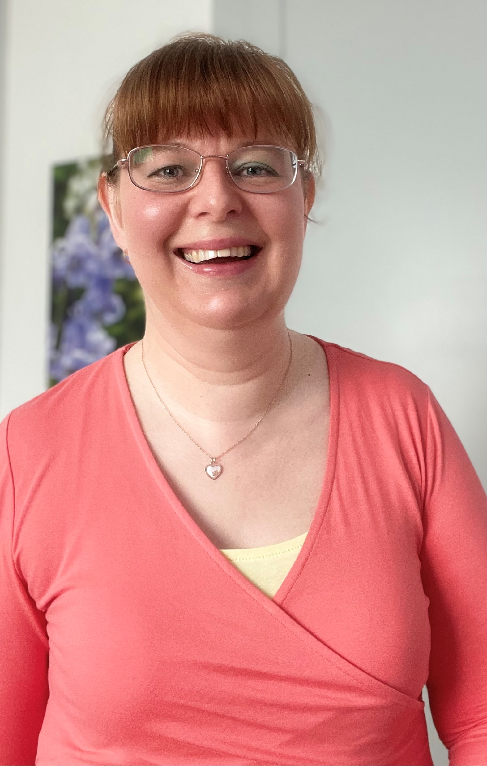
Montgomery Simpson
Realise Potential, Achieve Compliance, Inspire Confidence

Slide 2
The Learning Disability Training Facilitator
“I offer virtual online learning disability training for Supported Living and FE teams. Well-trained teams know how to achieve best outcomes with individuals and feel empowered in their roles. The Oliver McGowan mandatory training provides foundations for training in the learning disability sector, which I will support your staff to build upon.”
Nicola Simpson

Slide 3
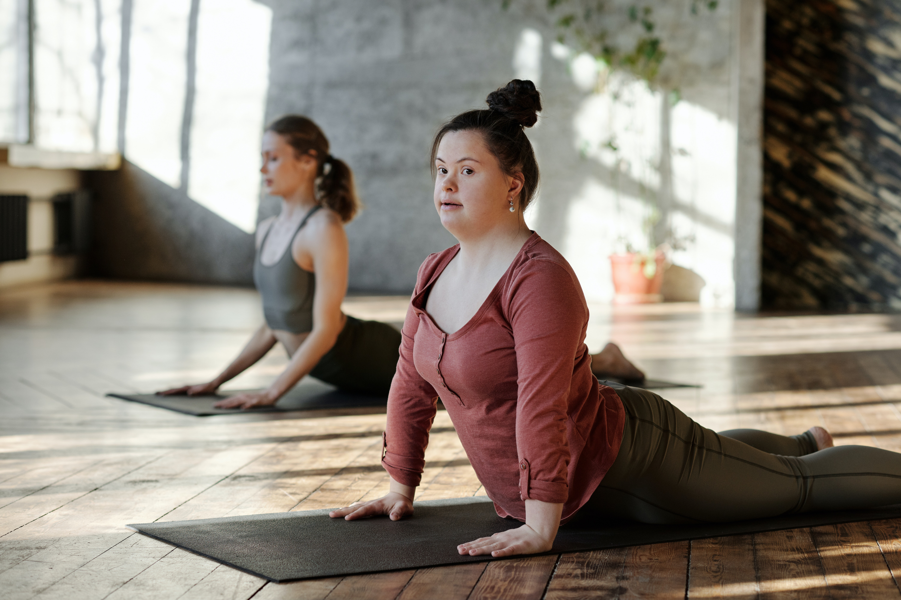
Creating tailor-made learning disability training which…
Realises potential- empowers individuals to live their best lives on their terms
Achieves compliance- transformative approaches, leading to Outstanding person-centred support
Inspires confidence- equipping teams with the tools and autonomy to confidently fulfil their roles

Slide 4
The Learning Disability Training Facilitator
Tailored, Empowering Learning Disability Training
Individuality:
Showing up consistently as our authentic selves
Referring to people as “individuals with a learning disability”
Creating a personal learning journey for each delegate
Independence:
Role modelling people with disabilities can be independent, expert and successful
Designing around learning styles and using perspectives of individuals with a learning disability
Experience:
Using lived and professional experience to inform case studies and co-production opportunities
Using a trauma-informed approach to design and deliver material
Empowerment:
Using positive energy to facilitate great sessions
Focusing on positive outcomes to enable everyone to live their best life
Delegates confident in their role
Fairness:
Across the board, for everyone, it’s a no-brainer!
Transformational Benefits to your Team:
Empowers individuals to live their best lives on their terms Transforms approaches to provide Outstanding person-centred support
Inspires your team to confidently fulfil their roles

Slide 5
Who?
I work with teams supporting adults with a learning disability
Based in Coventry, I offer virtual delivery via Zoom, to delegates across the UK

Slide 6
P course
I work collaboratively with learning disability teams to create effective solutions. My current course specialisms are An Empowering, Person-centred Support Culture, Learning Disability & Hearing Loss, and Learning Disability & Cerebral Palsy

Slide 7
How?
I offer tailored learning solutions, delivered using current, engaging resources
My learner-centred approach (Tailored, Empowering Learning Disability Training) is based on understanding the unique training needs of each client
Developing rapport with each training delegate to inspire and energise

Slide 8
What They Say…
“Great session this morning, would highly recommend, thank you Nicola for sharing your expertise and knowledge. It was lovely to meet you”
Delegate, “Learning Disability & Cerebral Palsy: An Introduction”
“Loved the questions for the group discussions.”
Delegate, “Creating an Empowering, Person-centred Support Culture”

Slide 9
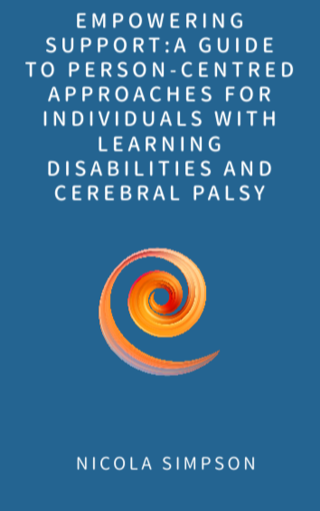
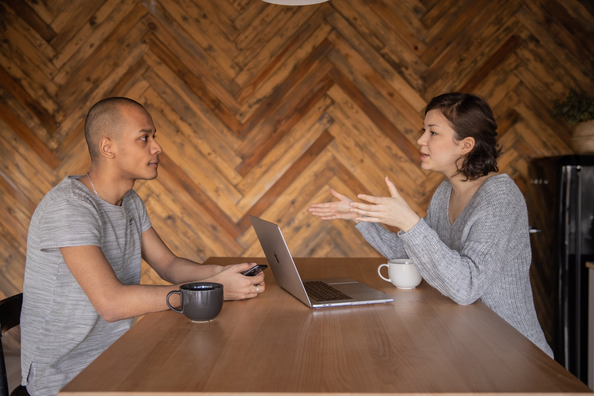
How to Work with Me
Tailor-Made Training Courses
Buy the eBook
Disability Consultancy

Slide 10
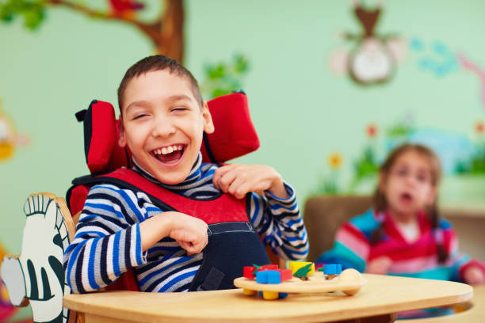
Coming Soon….
Learning Disability & Cerebral Palsy
The new Masterclass Series
-supporting you to enable individuals with a learning disability and cerebral palsy to live their very best lives!

Slide 11
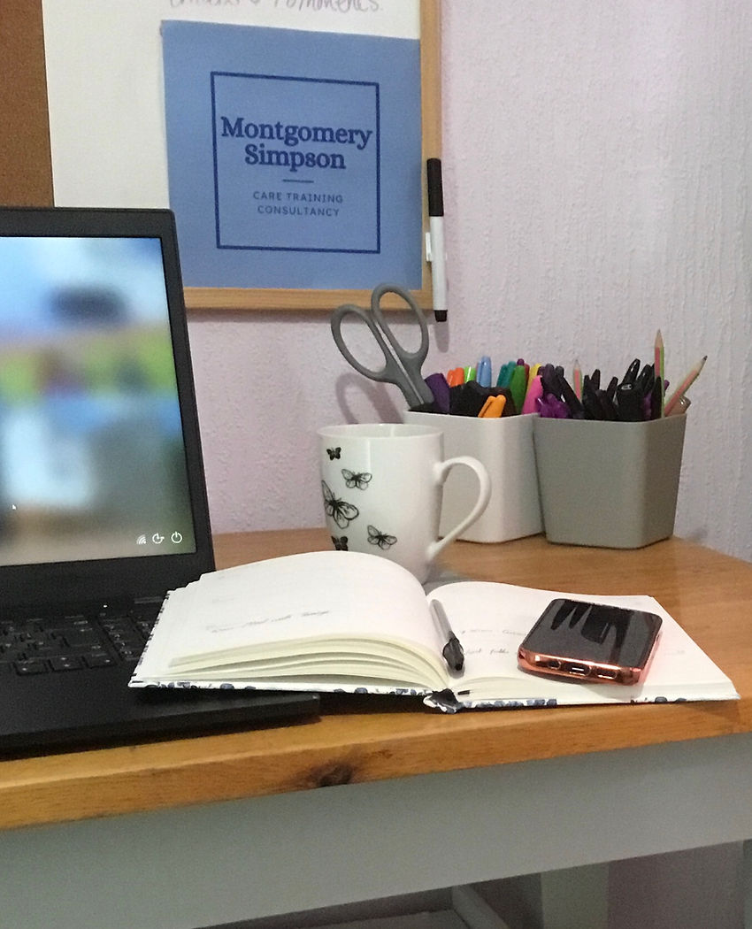
Stay in Touch
To get hold of your copy of the new Course Brochure, please get in touch:
nicola@montgomerysimpsoncaretraining.com
Tel.: 07803807208
Or take a look at the website:
www.montgomerysimpsoncaretraining.com

